Slide 1
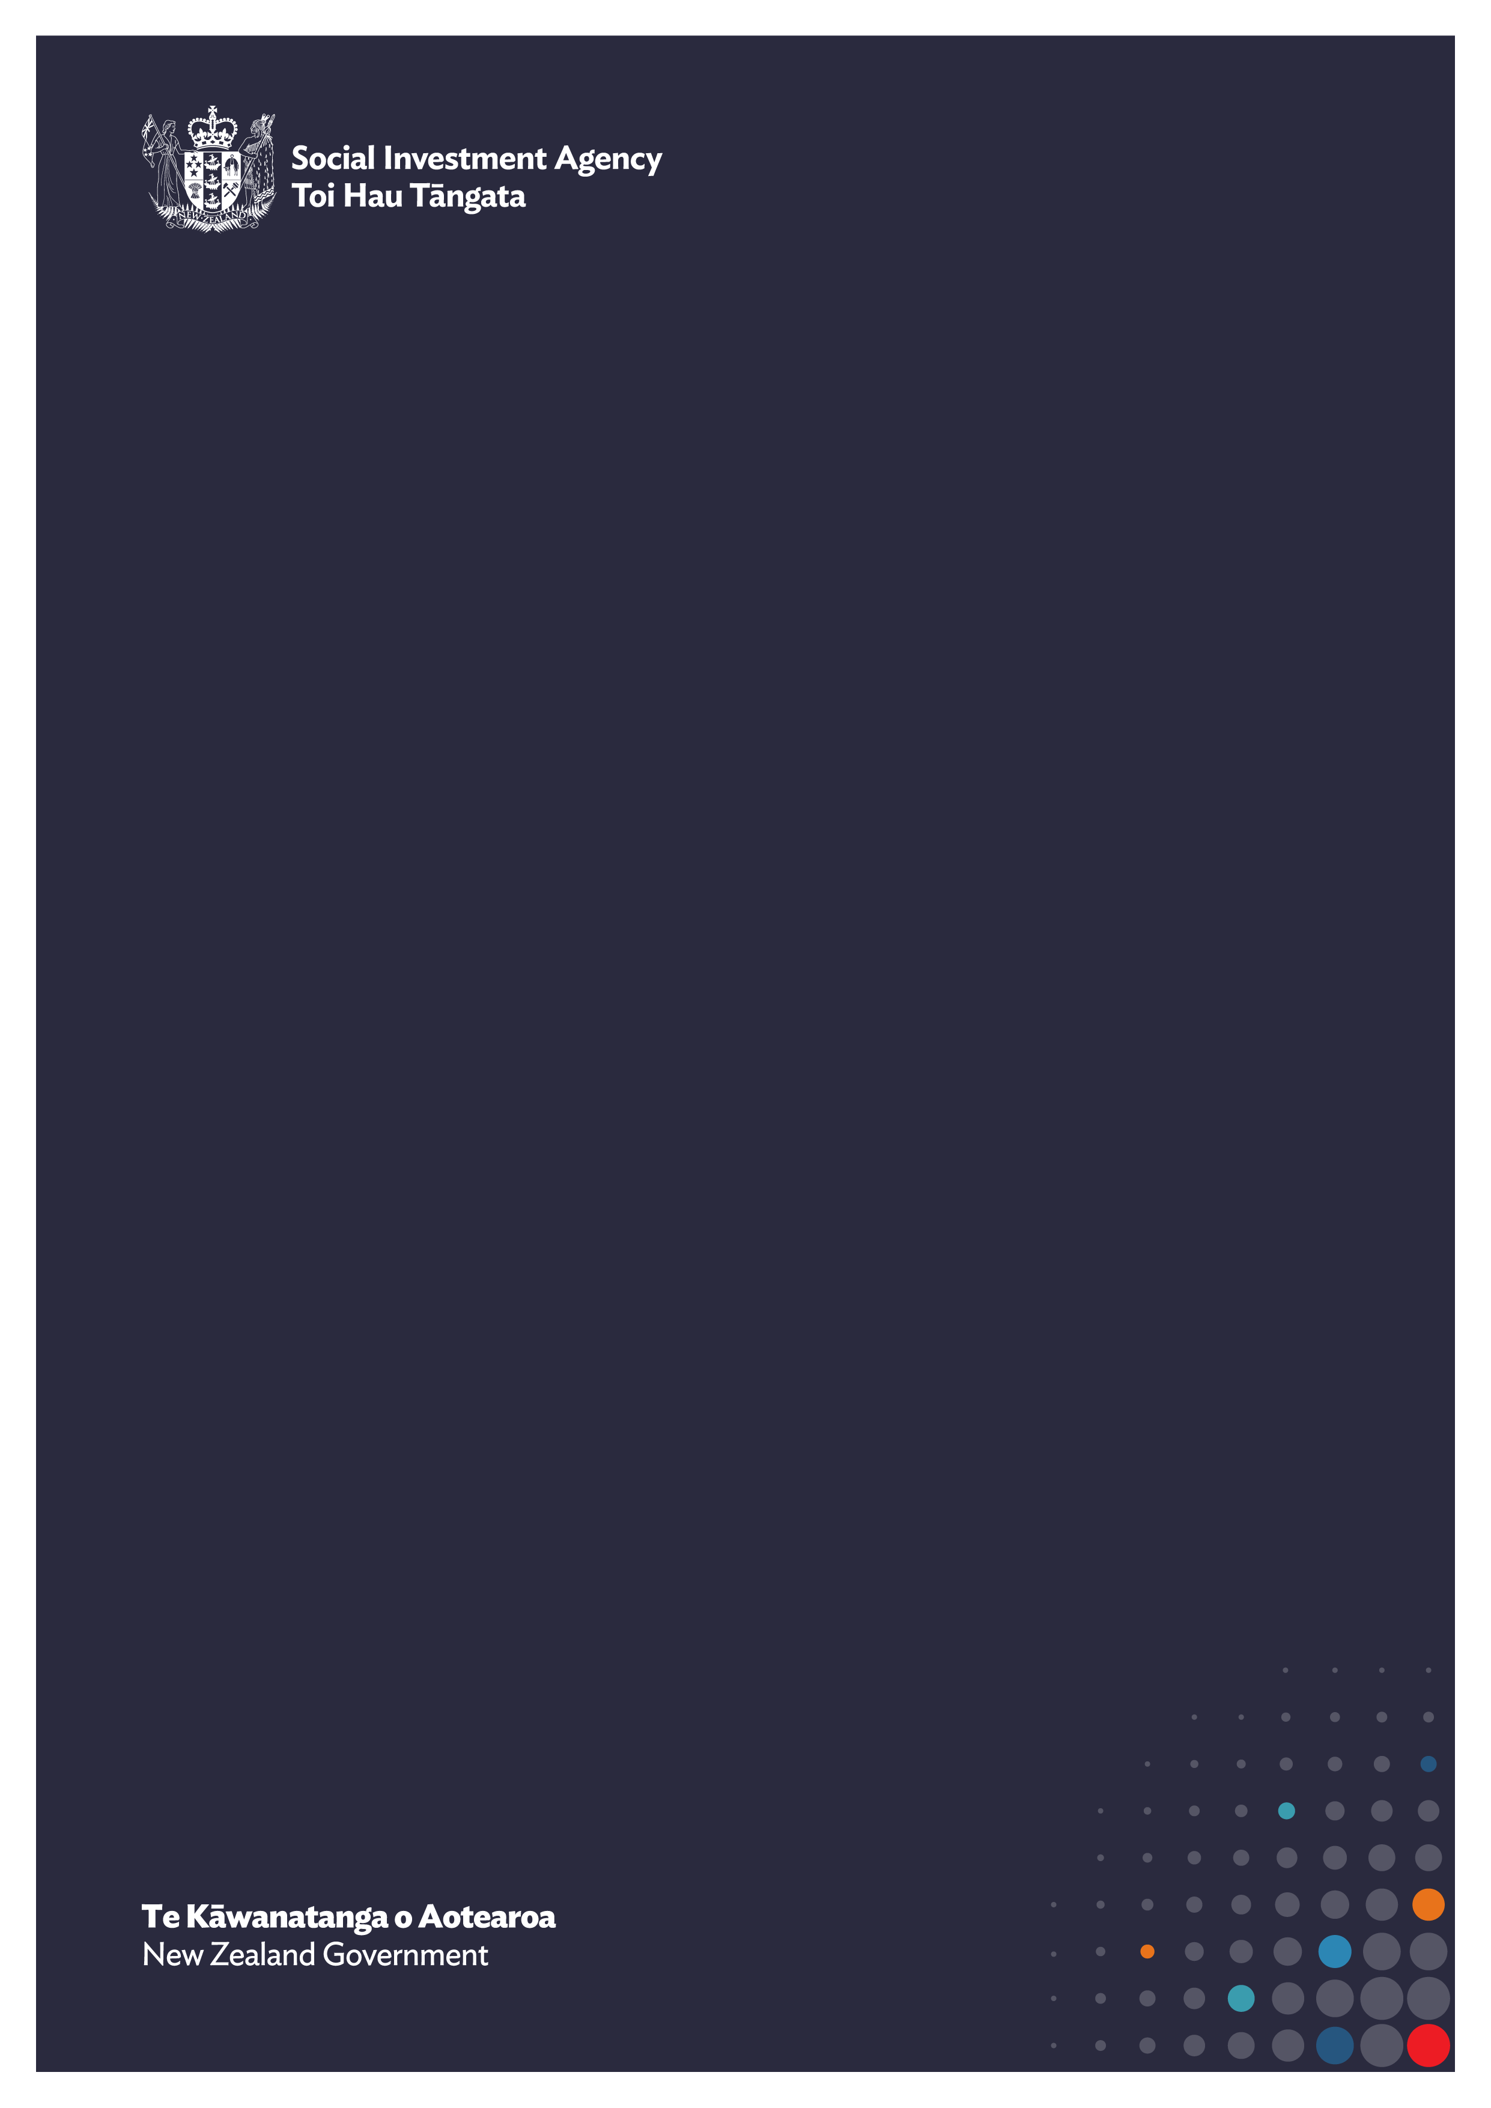

Sharing data with Stats NZ
This visual guide outlines the steps government agencies can follow to support organisations to share data with Stats NZ, from early conversations through to receiving insights back from the IDI.

Slide 2



Social service organisation information sharing process
Contracting government agency
Social service organisation
Initial meeting with social service organisation
Share Data Sharing Guidance
Review Data Sharing Guidance
Meet to discuss guidance and requirements
Complete data specification and privacy statements
Review data specification and privacy statements
Review data specification and privacy statements
Complete Privacy Impact Assessment
Prepare Data Sharing Agreement (DSA) & Confidentiality Agreement (CA)
Receive DSA and CA
Apply for access to research project
Review and sign DSA and CA
Review and counter sign DSA & CA
Extract data according to Data Standard
Set up Secure File Transfer with social service organisation
Upload data via Secure File Transfer Protocol
Data integrated into Stats NZ IDI
Access granted to IDI research project
Fast Match link if required
Run data output
Output checked by Stats NZ
Receive output & produce Data Dashboard
Access Data Dashboard

