Slide 1


Slide 3
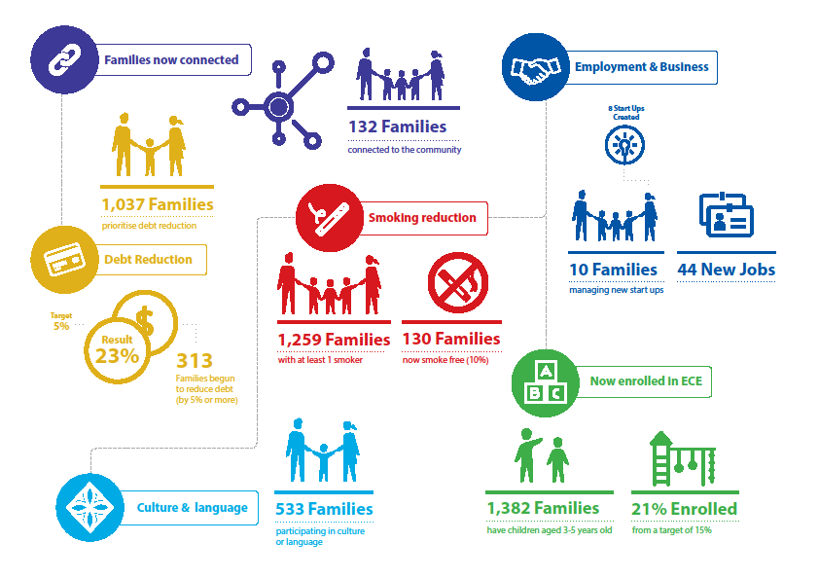

Slide 4
The Challenge
Collecting ethnicity specific data
Focusing on the right data to answer the right questions
Finding new ways to describe and value both the investment and contribution
Understanding the need for quality data
Changing from output to outcome data

Slide 5


Working together to break through the barriers
First principles:
Partnership rather than
paternalism
Collaboration rather than
control
Strengths based rather than
deficit focus
Solution focused rather than problem based

Slide 6


Slide 7
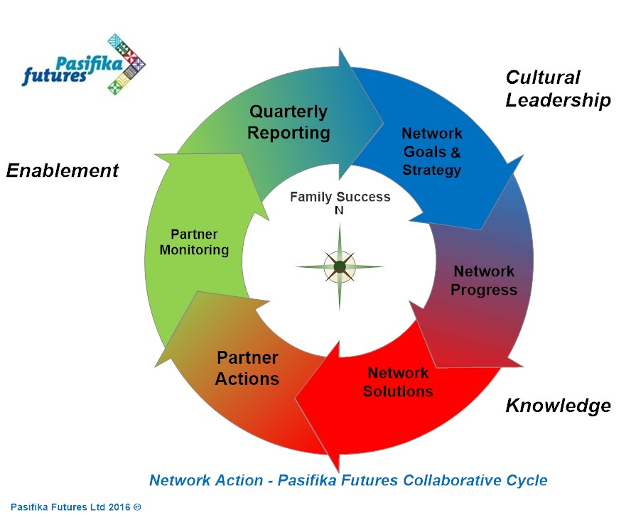

Slide 8
O
Data Quality Enhancement Strategy
Enhancing Insights
Enhancing Skills
Enhancing Systems
Internal Evaluation Project
Capability Assessment of Information System Users
Data Systems Review Project

Slide 9

Completing financial plans
or budgets
Target: 80%
Result: 39%
370/955 families
2035 individuals
Notes:
The first set of3 indicators measures financial literacy and the movement to reduce debt.
This first indicator measures families who have prioritised debt reduction – that is they have a debt reduction goal in their family plan and we are looking to see if those families have completed financial plans or budgets and so are on the path to becoming economically independent
Our target is 70%
Our result from our last quarter reports is 60% have completed a financial plan or budget
This result shows we are on track to achieving our target of 70% by June 30 2016…
With 319 families out of 529 completing a financial plan or budget.

Slide 10

2.
Begun to reduce debt
(by 5% or more)
Target: 20%
Result: 29%
252/955 families
1,386 individuals
Notes:
2. The second indicator again looks at those families who have prioritised debt reduction,
And have begun to reduce their debt by 5% of more
Our target is 5%
Our result is 18% have reduced their debt by 5% or more
So we have achieved our target with
87 out of 487 families reducing their debt

Slide 11

3.
Started on a Pathway to increase income
Target: 30%
Result: 20%
176/698families
968 individuals

Slide 12

4.
Now
enrolled in
ECE
Target: 30%
Result: 21%
261/1219 families
913 children
Notes:
The third ECE indicator measures enrolment in ECE
This indicator measures engaged families who at registration were not enrolled but are
NOW ENROLLED IN ECE
Our target is 15%
Our result is 24%
With 101 out of 425 families – with children participating in ECE

Slide 13

5.
Families have a health plan
Target: 80%
Result: 44%
650/1463 families
3575 individuals
Notes:
This indicator measures those families who have prioritised health and have a health plan.
Our target is 60%
Our result is 50%
Or 301 out of 608 families have a health plan

Slide 14

6.
Now
Smoke Free
Target: 15%
Result: 14%
149/1042 families
820 individuals
Notes:
This Indicator measure families who were smokers (with 1 or more members who were smokers) and are now smoke free
The target is 10% and the result is 9%
Or 55 out of 600 families

