Slide 1
Data Hui
November 2016
Liz MacPherson
Government Statistician and Chief Executive
November 2016

Slide 2
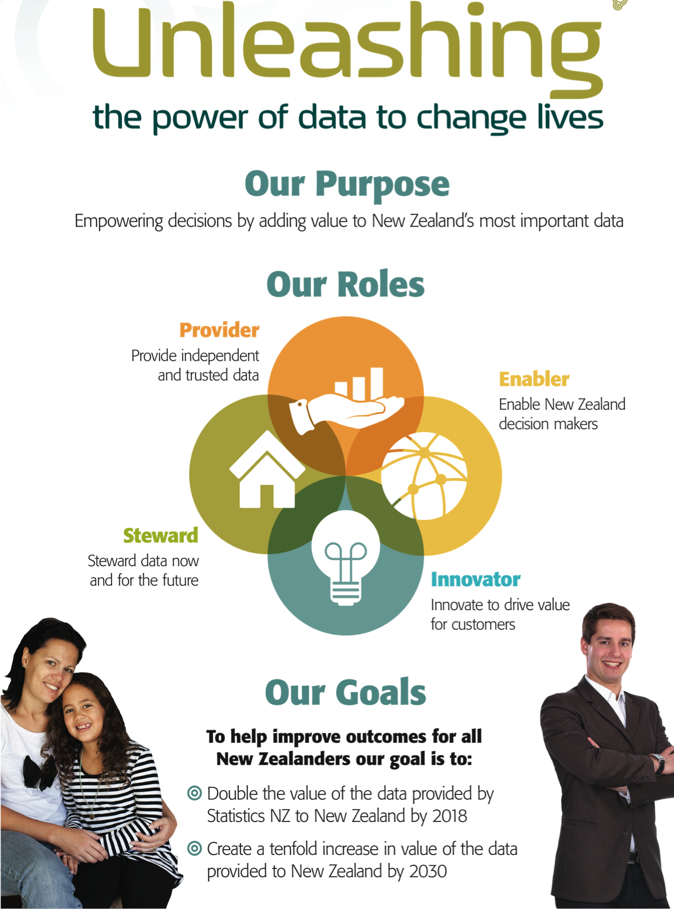
Notes:
Last week, following the earthquake that impacted on our building and IT systems, it was confirmed to me how resilient, committed, innovative and supportive of each other Stats NZ staff really are.
We have been overwhelmed with messages and offers of support from all sectors of the community. Thank you to you all.
This is in part reflective of the work we have been doing over the last couple of years to connect with various communities who can work with us to unleash the power of data. It is great to be part of a larger support network of friends and partners.
Our partnership approach is to stand together with senior leaders to learn together, break new ground, bring new perspectives, and actively work together to progress towards our goals.

Slide 3
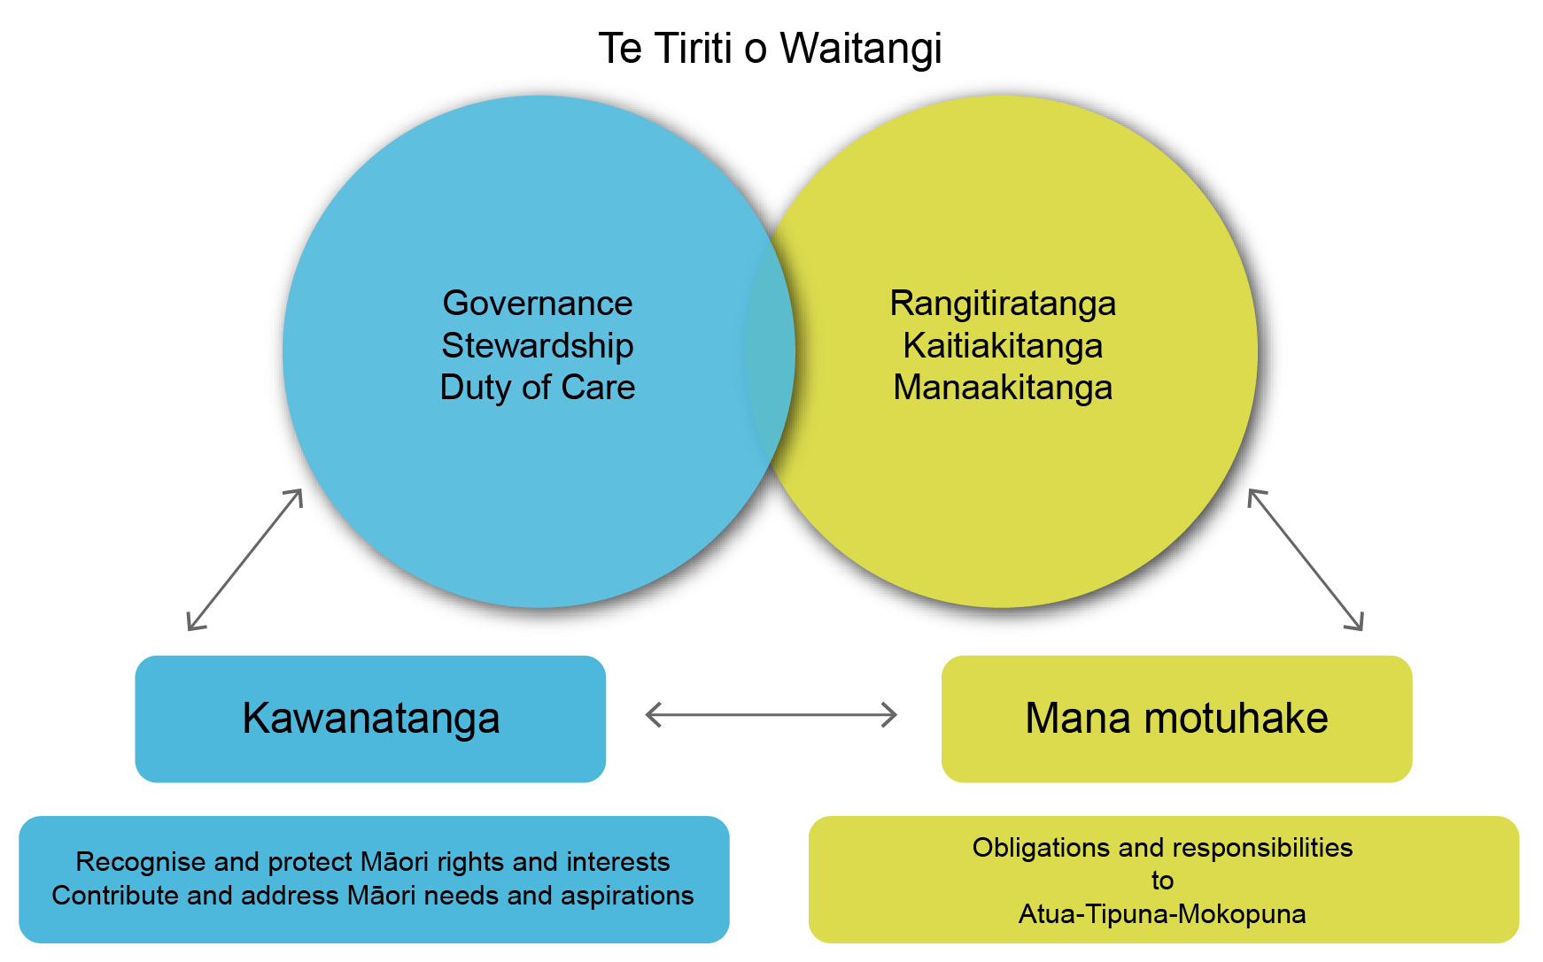
Partnering with iwi and Māori
Notes:
One of our roles is as kaitiaki (guardian) of government data. This has implications for iwi and Māori around the management of data, its integrity, privacy and security and what this means for our respective and collective kaitiaki roles.
We apply a co-development model approach, working in partnership with iwi and Māori to explore how data can offer insights and collaborating to create value from the data we hold. For example, the combination of census and integrated data is a very powerful resource for iwi and Māori to better understand their data.
Our aim is to grow value for iwi and Māori and work in partnership so iwi and Māori can drive and lead projects that inform their own strategies and decision making for social and economic development.
The projects we are collaborating on are on real-world issues to develop new, relevant and innovative products and services. Each project creates new value from data to improve wellbeing. These projects provide an opportunity for us to understand more about iwi and Māori data needs, as well as improving the way we respond to customized data requests. Our focus on taking a strong strengths-based approach and work with you to use data and tell your own stories, build capability and enable success and wellbeing.

Slide 4

Pilot Partnership Projects
Statistics NZ
Iwi & Māori
NGOs
Notes:
We have a history of working with communities to ascertain how best to enable and support the use of data for decision-making.
I want to give you an update on the pilot partnership projects that we established earlier in the year. These are examples of partnerships and action. Progress us encouraging and we’re learning a lot in the process.
With the Southern Methodist Mission we are providing insights into methods to provide safe access to integrated data for non-government organisations. We’re also looking at research issues relating to services deliver and policy settings in the areas of young mothers with no qualifications, and profiling and locating youth in Otago who are not in education, employment (NEET).
The indicators are being developed to help Southern Methodist Mission to better understand their clients’ characteristics. The working we’re doing with SMM will be transferable to other NGOs.
We’re working Te Rūnanganui o Ngāti Porou on supporting the identification and interpretation of data to aid populating the social domain of their Outcomes Measurement Framework.
With Te Mana Raranga we have implemented a rohe-identification process for iwi and Statistics NZ, and the identification of iwi-validated rohe boundaries for all iwi and hapū.
It’s been great having Felicity from Te Tihi o Ruahine with us for the last few months to build and improve Te Tihi’s analytical and statistical capability. It’s an opportunity for usboth to broaden networks and support the onlging and innovative work of Te Tihi. To date we have put a framework around data collection, questionnaire design, a measurement framework to better understand information needs.
Te Tihi are a hands-on organisation, working with whānau in the community. In partnering with Te Tihi, Statistics NZ heard real world stories about whānau. Statistics NZ can lose sight of this perspective, and this project has acted as a powerful reminder that Statistics NZ needs to more frequently consider the needs of the wider community if it is to unleash the power of data to change lives.
Statistics NZ has seen first-hand how fast-moving and responsive a community-based organisation, such as Te Tihi, needs to be. Partnering with Te Tihi has provided Statistics NZ a perspective on how an organisation can move quickly from identifying information needs to the collection of that information. Statistics NZ has learned that there is a need to streamline its processes to match that pace. In particular, Te Tihi’s use of an online questionnaire to deliver their survey provided Statistics NZ insight into that process and an early glance at specific tools.
The work we’re doing with Ngāi Tūhoe is about providing insights on children at risk and on the significance of te reo Māori. We are progressing work on a literature review of language retention and the strength of te reo Māori.
With Ngāi Tahu we have started a piece of work to research life pathways for tribal youth. We are working towards gaining an indepth understanding of needs. Using the Ngāi Tahu ‘State of the Nation’ report, we are selecting specific outcomes for Ngāi Tahu on specific areas including: housing tenure, employment, Māori business, cultural factors, well-being, and educational outcomes.
The Minister mentioned the partnership we’re in with Waiora Pacific. We are in the process of identifiying suitable data to populate the Takiwa platform for whanau.

Slide 5
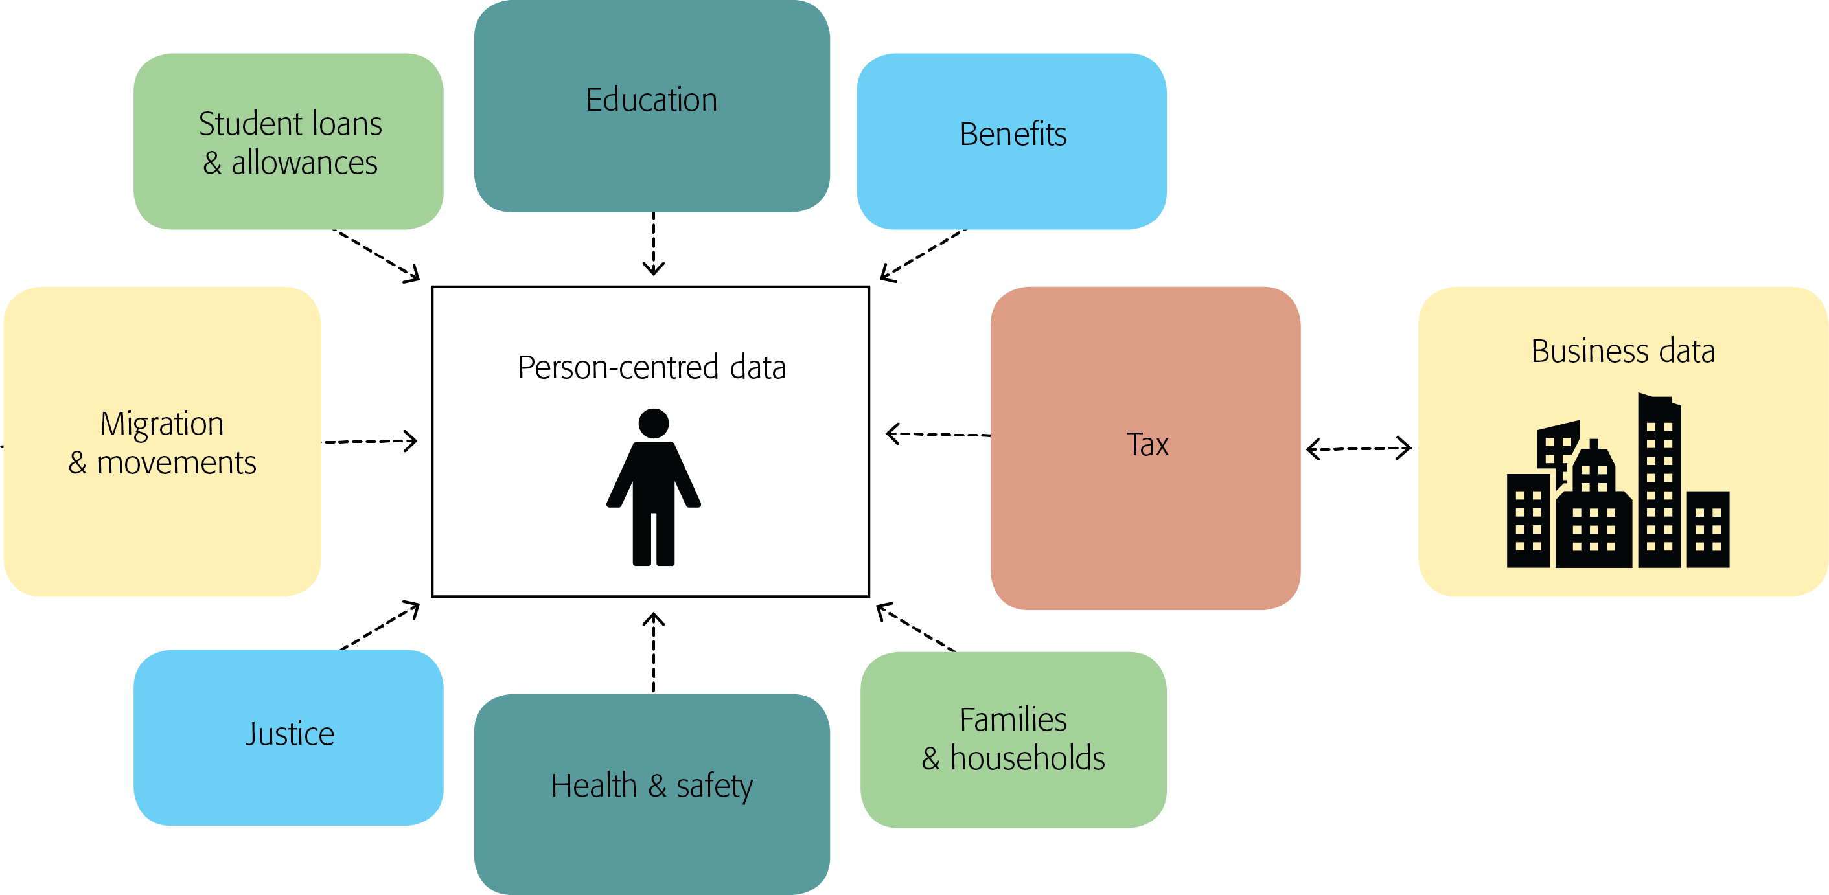
Integrated Data Infrastructure (IDI)
An integrated database containing confidentialised longitudinal microdata about people, households, and businesses
For a full list of data, go to www.stats.govt.nz/idi
Notes:
The IDI is a large integrated database containing confidentialised longitudinal microdata about people, households, and businesses. It is essentially a data service. It joins together data from across government and survey data from Stats NZ. It is a constantly growing source of data – we update the data every quarter and continue to integrate new datasets. The IDI contains income data from IRD, benefits data from MSD, multiple health datasets, educational attainment, boarder crossings and births and deaths, there’s justice sector information in there and Housing New Zealand data. The longitudinal aspect means that we can look backwards in time to see impacts and outcomes for people with certain characteristics.
The IDI is not about locating individuals. It’s about finding groups of people with certain “characteristics” so decision-makers can implement polices to reach the people who most need it.
Personal information is not seen by researchers. The information is anonymised. Personal identifying information like names, addresses and days of dates of birth are removed before being released. Secondly, all research findings are confidentialised. This means that information is grouped in a way that makes it impossible to identify individual people.
In the last update we incorporated Auckland City Mission data which is the first time we have added data from an agency outside government. The data includes a wealth of information such as income, expenses, housing status and household composition of Mission clients, and information about the services these clients use. This inclusion enables further research about the experiences of marginalised people with the aim of enhancing services for them, and ultimately improving lives.
I have recently approved the inclusion of the NZ Disability Survey and Te Kupenga survey information into the Integrated Data Infrastructure (IDI). Including Te Kupenga gives us particularly useful answers for smaller populations. This is one of the reasons why it’s more important than ever that communities complete Census forms, because it enables us to do so much more with data. You complete the form and we’ll give you better information.

Slide 6
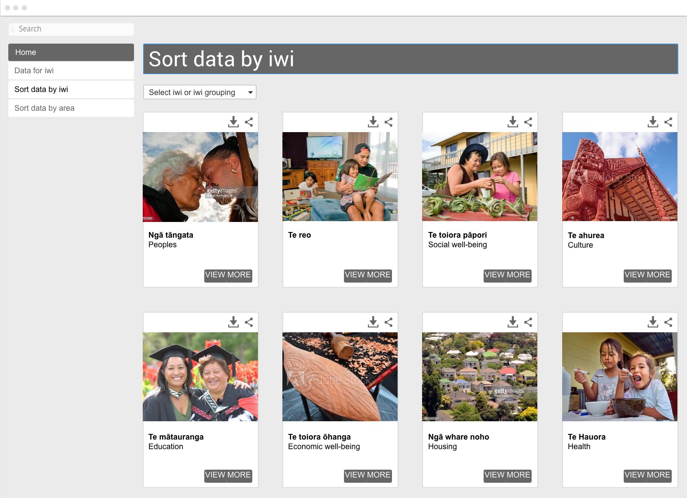
Data for iwi
Notes:
We have started a journey to develop a new way of making iwi and Mâori data and statistics more easy for you to find and use on our website.
The new direction has clear design principles: to be for Mâori, incorporate te ao Mâori, and be available in te reo. It will enable a more holistic picture of Iwi than we currently provide; one that brings together the various information Iwi and Maori have entrusted to us, and that reflects the information needs we hear you asking for.
I am pleased to be able to give you a very early preview of our prototype iwi data interface. It starts by drawing on the published 2013 Census and Te Kupenga data, but over time will grow to include data from more sources, such as those in the IDI.
As this landing page shows, you will be able to select your iwi or iwi group, and then explore data grouped by topic, such as Te reo, Education, and Social well-being.
This is just a starting point; an early example of what it might look like. This prototype has been developed in consultation with a small group, however, we are keen to engage directly with more of you to ensure we are on the right path, before it is released for wider feedback.
We hope to make the first production version live in 2017, and continue to develop it from there.
We know that our customers want detailed regional level data with a strength and wellbeing focus, so the greater the detail we can get from the community, the larger the data pool we can provide for iwi and Māori to gain better insights from data.
We understand about the importance of community engagement and are focussed on engagement with Maori communities to increase Maori Census participation. Our priority is to build trust in the safety and security of information, increasing relevance of Census participation and improving accessibility for those with barriers. We have established a dedicated team to focus on engaging with regionally dispersed and high need areas.
Our focus is working collaboratively with communities to empower them to develop and design regionally specific engagement activity.
Te Reo as the primary language version is being constructed.

Slide 7
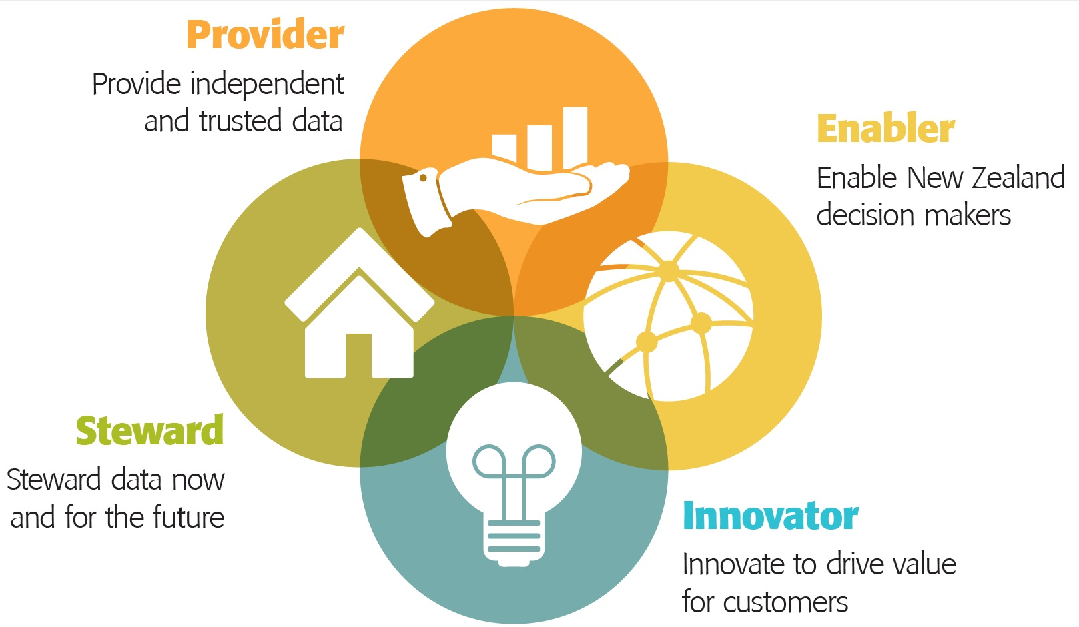
Unleashing the power of data to change lives
Notes:
Kia ngātahi te waihoe
Tahuri te kei o tō waka, whatiwhati ngaru
Haere ki tua, papapounamu te moana
E topa, e rere ki uta
Let us paddle in unison
Turn the front of the canoe into the waves and push through them
Because past the waves the ocean is flat
And we will speed off into the distance

